Slide 1
QUANTITATIVE METHODS FOR FINANCE – TCHE442
Instructor: Nguyen Thu Hang
nguyenthuhang.cs2@ftu.edu.vn

Slide 2
Course materials
Brooks, C., 2014. Introductory econometrics for finance. Cambridge university press.
2. Introductory Econometrics- A modern approach
by Jeffrey M. Wooldridge (Ch1-9)

Slide 3
Assessment
Performance: 10%
Mid-term test + project: 30%
Final exam : 60% (Written exam MCQ &/or problem-solving questions - 60 minutes)

Slide 4
Outline
Chapter 1: Introduction (6 hours)
Chapter 2: Simple Regression (6 hours)
Chapter 3: Multiple Regression (6 hours)
Chapter 4: Dummy Variable Regression Models (6 hours)
Chapter 5: Univariate time series modeling and forecasting (3 hours)
Chapter 6: Multivariate models
Chapter 7: Panel data (6 hours)
Chapter 8: Simulation method
Empirical Research + Presentation (9 hours)

Slide 5
What are your expectations for the course?

Slide 6
Examples of empirical research
This thesis examines the relationship between the probability of financial distress and some specific financial ratios in order to identify internal factors causing distress for firms. (Phu Kim Yen, K49 CLC)
Findings: Size has negative coefficients which are statistically significant at significance level of 1% in all estimations. This finding is consistent with previous study of Ohlson (1980). The author concludes that size affect the probability of financial distress of Vietnamese listed firms, especially those on HOSE. In reality, large-cap companies often have more power in its trading position with counterparties as well as more approaches to financing resources. Therefore, it is easier for them to weather unexpected downturns

Slide 7
Examples of empirical research
This thesis analyzes determinants of commercial banks’ net interest margin in Vietnam (Hoang Trung Khanh, K49CLC).
Findings: Operating expense has positive coefficients which are statistically significant at the significance level of 1% in all estimations. This finding is consistent with previous studies of Abreu and Mendes (2003) and Maudos and Fernández de Guevara (2004). We conclude that operating expense affect Vietnamese banks’ NIM positively and accept hypothesis H1 established earlier. As operating expense gets larger, banks would tend to pass on the increasing cost of operating inefficiency to the public in the form of higher loan interest, which in turn would result in a higher value of NIM.

Slide 8
Examples of empirical research
This thesis examines the relationship between the probability of financial distress and some specific financial ratios in order to identify internal factors causing distress for firms. (Phu Kim Yen, K49 CLC)
Findings: Size has negative coefficients which are statistically significant at significance level of 1% in all estimations. This finding is consistent with previous study of Ohlson (1980). The author concludes that size affect the probability of financial distress of Vietnamese listed firms, especially those on HOSE. In reality, large-cap companies often have more power in its trading position with counterparties as well as more approaches to financing resources. Therefore, it is easier for them to weather unexpected downturns.

Slide 9
Instruction for your project
Each group (max. 5 students) should write and present a short report (max. 15 pages all included) based on the data and introduction given during the course.
The report should be organized as follows:
1. Introduction: Give a brief statement about the motivation and purpose of the study.
2. Literature Review
Summarize the main published work concerning your research question.
It should be a synthesis and analysis of the relevant published work, linked at all times to your research question.
State your hypotheses
3. Methodology and data
An introduction of your model (dependent and independent variables)
A description of the data must be provided here. You should discuss the data sources and the definition of variables and report in a table summary statistics such as minimum and maximum values, means, standard deviations for each variable.
4. Results: Estimation results are provided in a table and discussed in this section.
5. Conclusion: you should summarize the results here.

Slide 10
CHAPTER 1
INTRODUCTION TO ECONOMETRICS

Slide 11
The Nature and Purpose of Econometrics
Why do you need to learn Econometrics?
What is Econometrics? What will you learn from the course?
How do you learn? Methodology of Econometrics
Terminology and notation
Types of data
Introduction to Stata
Notes:
(45min)

Slide 12
1.Why do you need to learn Econometrics?
Economics suggests important relationships, often with policy implications, but virtually never suggests quantitative magnitudes of causal effects.
What is the quantitative effect of reducing class size on student achievement?
How does another year of education change earnings?
What is the price elasticity of cigarettes?
What is the effect on output growth of a 1 percentage point increase in interest rates by the Fed?

Slide 13
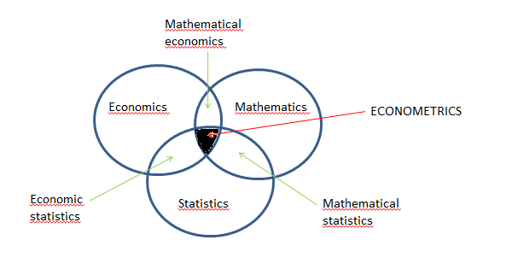
2. What is Econometrics?
Econometrics = “economic measurement”.
“Econometrics may be defined as the social science in which the tools of economic theory, mathematics, and statistical inference are applied to the analysis of economic phenomena” (Goldberger 1964).

Slide 14
Typical goals of econometric analysis
Estimating relationships between economic variables
Testing economic theories and hypotheses
Forecasting economic variables
Evaluating and implementing government and business policy

Slide 15
In this course you will:
Learn methods for estimating causal effects using observational data
Focus on applications – theory is used only as needed to understand the “why”s of the methods;
Learn to evaluate the regression analysis of others – this means you will be able to read/understand empirical economics papers in other econ courses;
Get some hands-on experience with regression analysis in your problem sets.

Slide 16
3. Methodology of Econometrics
1. Statement of theory or hypothesis .
2. Specification of the mathematical model of the theory
3. Specification of the statistical, or econometric, model
4. Collecting the data
5. Estimation of the parameters of the econometric model
6. Hypothesis testing
7. Forecasting or prediction
8. Using the model for control or policy purposes.

Slide 17
Statement of Theory or Hypothesis
Example: On average, consumers increase their consumption as their income increases, but not as much as the increase in their income (MPC < 1).
MPC= marginal propensity to consume

Slide 18
Specification of the Mathematical Model
Y = β₁ + β₂X 0 < β₂ < 1 (1)
Y = consumption expenditure (dependent variable)
X = income (independent or explanatory variable)
β₁ = the intercept
β₂ = the slope coefficient
The slope coefficient β₂ measures the MPC.
MPC= marginal propensity to consume

Slide 19
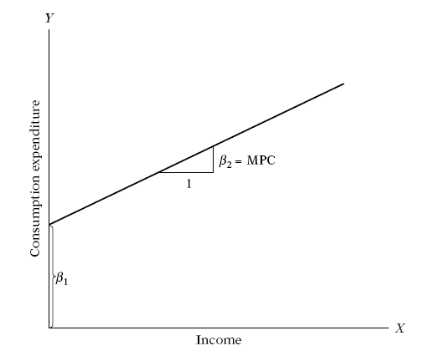
Example
Geometrically,

Slide 20
Specification of the Econometric Model
Other variables can affect consumption expenditure: size of family, ages of the members in the family, family religion → the inexact relationships between economic variables
To allow for the inexact relationships between economic variables, (1) is modified as follows:
Y = β₁ + β₂X + u (2)
where u = the disturbance, or error, term, a random (stochastic) variable that has well-defined probabilistic properties.
u may well represent all those factors that affect consumption but are not taken into account explicitly.

Slide 21
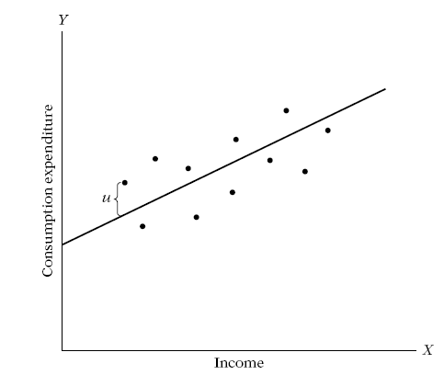
ExamPLE

Slide 22
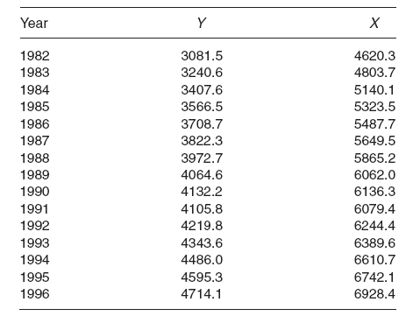
Obtaining Data
Y = personal consumption expenditure
X = gross domestic product

Slide 23
Estimation of the Econometric Model
Regression analysis is the main tool used to obtain the estimates. We obtain the estimates
β₁ = −184.08 and β₂= 0.7064
Yˆ = −184.08 + 0.7064X_{i} (3)
→ An increase in real income of 1 dollar led, on average, to an increase of about 70 cents in real consumption.

Slide 24
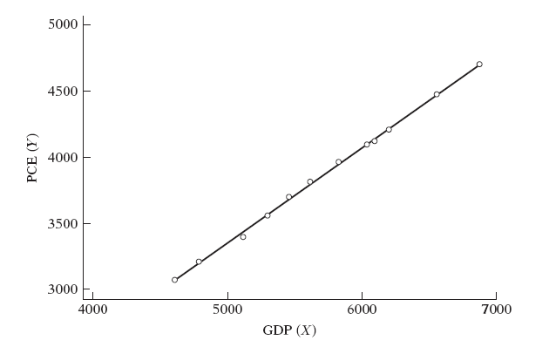
Example
The data are plotted in Figure I.3

Slide 25
Hypothesis Testing
Keynes expected the MPC to be positive but less than 1.
In our example MPC= 0.70 → we must enquire whether this estimate is sufficiently below unity. In other words, is 0.70 statistically less than 1? If it is, it may support Keynes’ theory.
Such confirmation or refutation of economic theories on the basis of sample evidence is based on a branch of statistical theory known as statistical inference (hypothesis testing).

Slide 26
Forecasting or Prediction
To illustrate, suppose we want to predict the mean consumption expenditure for 2015. The GDP value for 2015 was 7269.8 billion dollars consumption would be:
Yˆ2015 = −184.0779 + 0.7064 (7269.8) = 4951.3

Slide 27
Use of the Model for Control or Policy Purposes
Suppose the government decides to propose a reduction in the income tax. What will be the effect of such a policy on income and thereby on consumption expenditure and ultimately on employment?

Slide 28
4. Terminology and notation
Unless stated otherwise:
The letter Y will denote the dependent variable
The X’s will denote the independent variables, Xk being the
kth explanatory variable.
The subscript i or t will denote the ith or the tth observation or value.
N will denote the total number of observations or values in the population,
n will denote the total number of observations in a sample.
u or e will denote the random error or stochastic

Slide 29
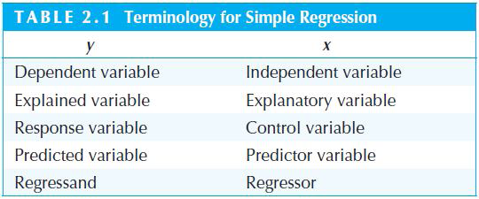
Terminology and notation
In the literature the terms dependent variable and explanatory variable are described variously. A representative list is:

Slide 30
5. Types of data
Different kinds of economic data sets
Cross-sectional data
Time series data
Pooled cross sections
Panel/Longitudinal data
Econometric methods depend on the nature of the data used
Use of inappropriate methods may lead to misleading results

Slide 31
Types of data
Cross-sectional data sets
Sample of individuals, households, firms, cities, states, countries, or other units of interest at a given point of time/in a given period
Cross-sectional observations are more or less independent
For example, pure random sampling from a population
Sometimes pure random sampling is violated, e.g. units refuse to respond in surveys, or if sampling is characterized by clustering
Cross-sectional data typically encountered in applied microeconomics

Slide 32
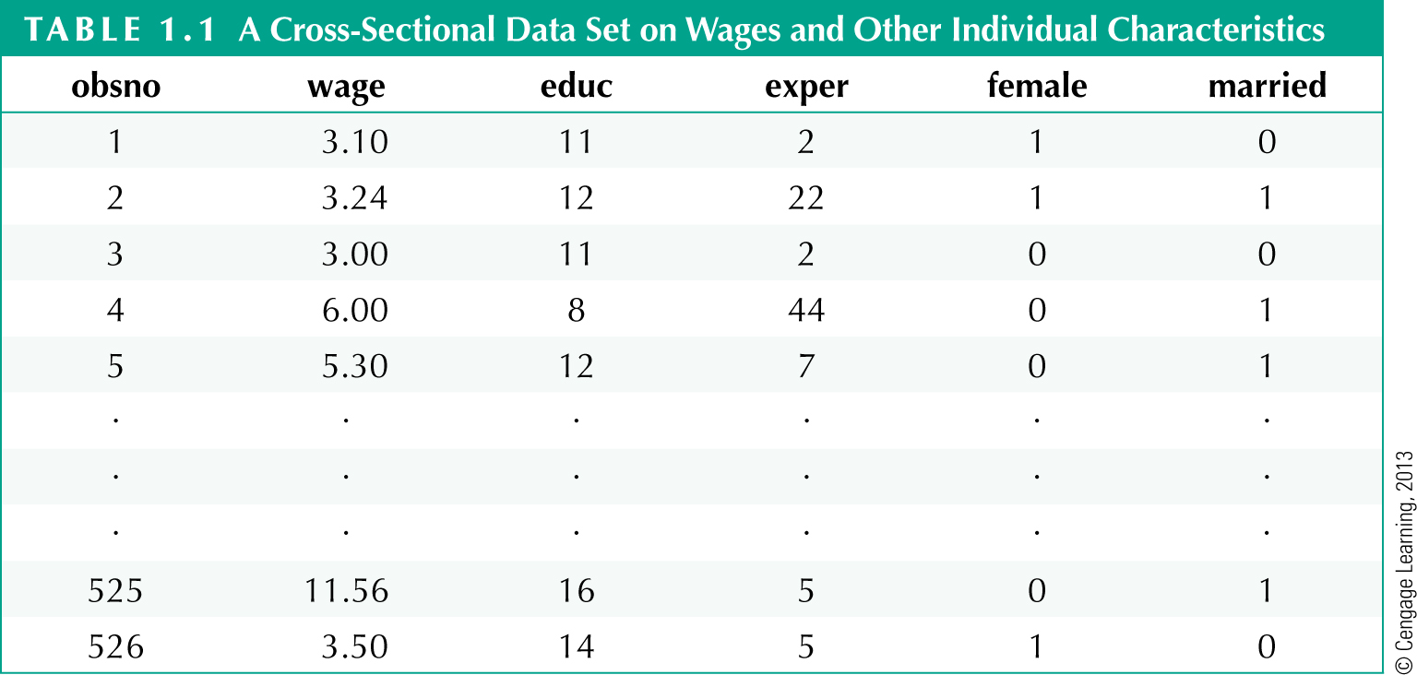
Types of data
Cross-sectional data set on wages and other characteristics
Indicator variables
(1=yes, 0=no)
Observation number
Hourly wage

Slide 33
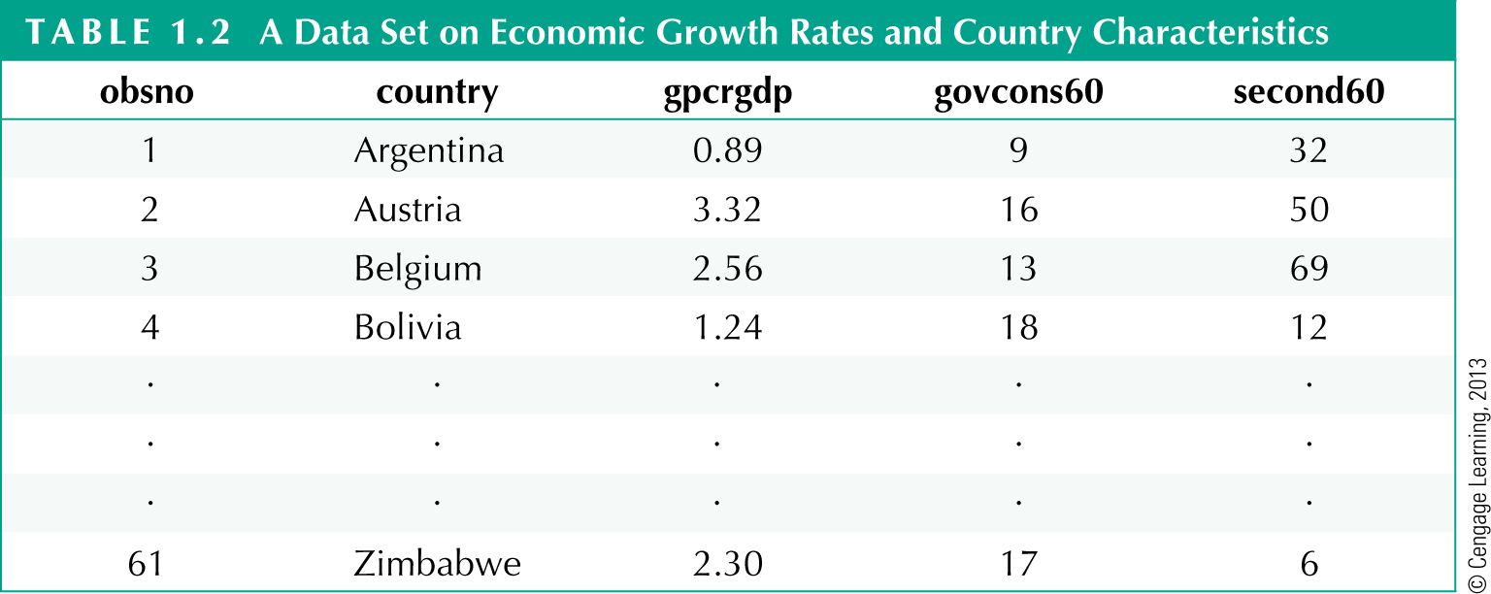
Types of data
Cross-sectional data on growth rates and country characteristics
Growth rate of real
per capita GDP
Government consumtion
as percentage of GDP
Adult secondary
education rates

Slide 34
Types of data
Time series data
Observations of a variable or several variables over time
For example, stock prices, money supply, consumer price index, gross domestic product, annual homicide rates, automobile sales, …
Time series observations are typically serially correlated
Ordering of observations conveys important information
Data frequency: daily, weekly, monthly, quarterly, annually, …
Typical features of time series: trends and seasonality
Typical applications: applied macroeconomics and finance

Slide 35
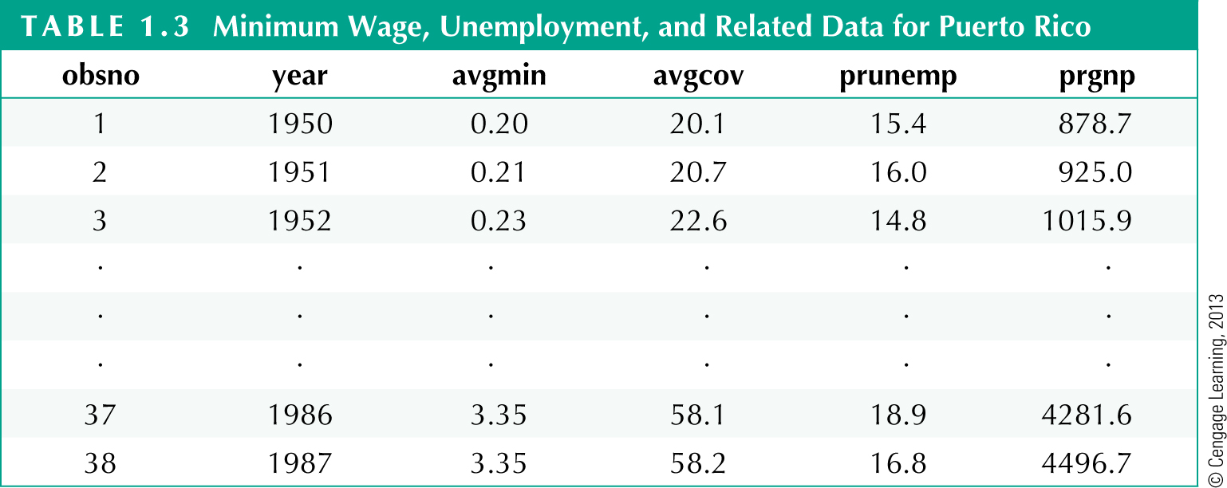
Types of data
Time series data on minimum wages and related variables
Average minimum
wage for given year
Average
coverage rate
Unemployment
rate
Gross national
product

Slide 36
Types of data
Pooled cross sections
Two or more cross sections are combined in one data set
Cross sections are drawn independently of each other
Pooled cross sections often used to evaluate policy changes
Example:
Evaluate effect of change in property taxes on house prices
Random sample of house prices for the year 1993
A new random sample of house prices for the year 1995
Compare before/after (1993: before reform, 1995: after reform)

Slide 37
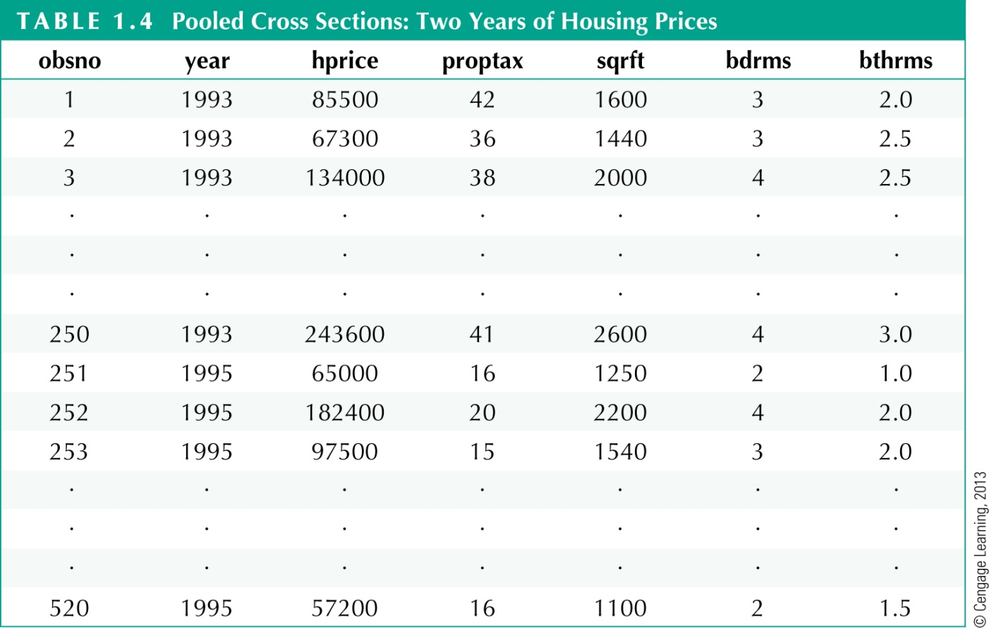
Types of data
Pooled cross sections on housing prices
Property tax
Size of house
in square feet
Number of bathrooms
Before reform
After reform

Slide 38
Types of data
Panel or longitudinal data
The same cross-sectional units are followed over time
Panel data have a cross-sectional and a time series dimension
Panel data can be used to account for time-invariant unobservables
Panel data can be used to model lagged responses
Example:
City crime statistics; each city is observed in two years
Time-invariant unobserved city characteristics may be modeled
Effect of police on crime rates may exhibit time lag

Slide 39
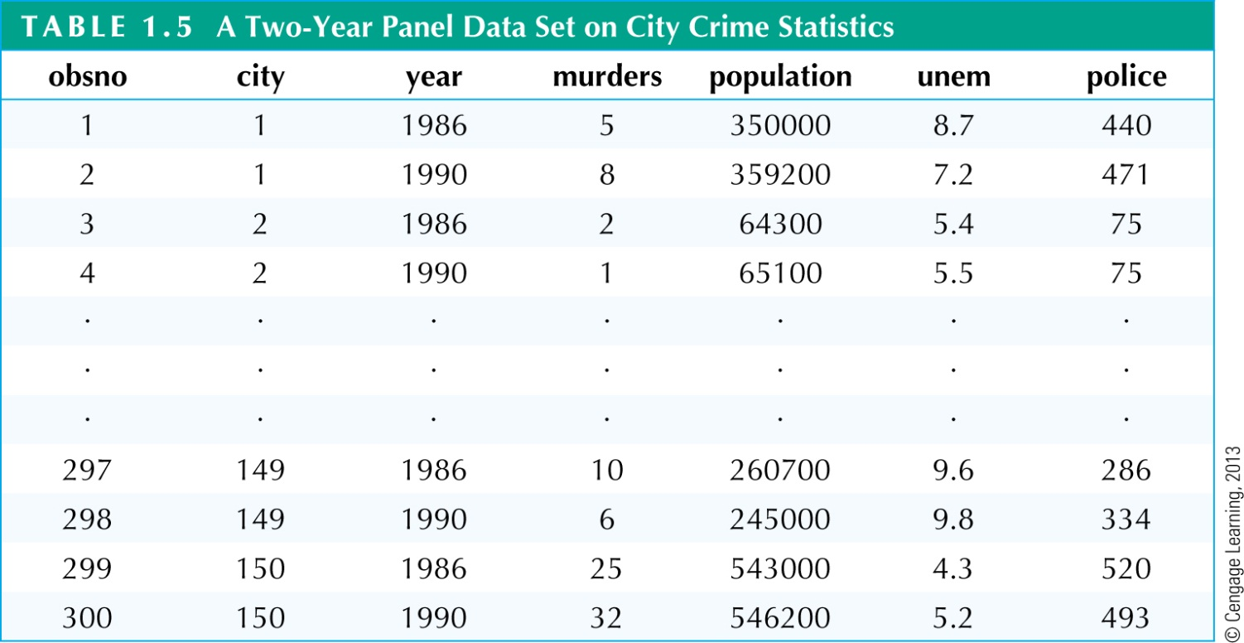
Types of data
Two-year panel data on city crime statistics
Each city has two time
series observations
Number of
police in 1986
Number of
police in 1990

Slide 40
Measurement Scales of Variables
Four broad categories: ratio scale, interval scale, ordinal scale and nominal scale.
Ratio scale: GDP growth rate, interest rate, ROE. Most economic variables belong to this category.
Interval scale: the distance between two time periods, say (2000-1995)
Ordinal scale: income class (upper, middle, lower), grading systems (A,B, C grades)
Nominal scale: gender (male, female), marital status (married, unmarried, divorced, separated)

Slide 41
Introduction to Stata
How to cite a research paper
References

Slide 42
HOMEWORKS
Download data on stock prices of all firms listed on HOSE and HNX
Calculate daily return, weekly return, monthly return and annual returns
Merge the annual returns and the data on financial statements

